Slide 1
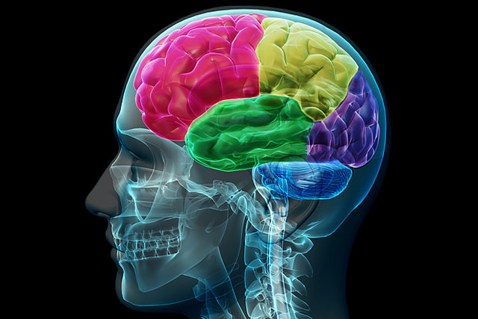

States of Consciousness
[Professor Name]
[Class and Section Number]
Notes:
Classroom Recommendations: The Brain and the Nervous System is a module that can be taught in one or two class periods, although most people cover the material in a single period.
Overview: The main topics covered in this lecture include: 1) levels of awareness, 2) hypnosis, 3) sleep and 4) psychoactive drugs
Technical Note: These slides may contain simple click animation so that you can focus students’ attention on a particular question, a selection of text, or an image and not have them be distracted by reading ahead. You can either preview the sequence of animation by going through the slides in slideshow view, visiting the animations tab, or reviewing the slide notes. In the notes you will see a cue - (Click) – that corresponds to each animation.
You may also find hyperlinks to outside videos at various places in the slides. These hyperlinks are embedded in text and indicated by color and in the notes section.

Slide 2

What is Consciousness?
How conscious are you when you make a decision?
How much are you aware of when you walk through a crowd at a mall or bus station?
How self-aware are you when you are alone in a car versus with friends or family members?
Notes:
Discussion: What is Consciousness?
Here, the instructor can introduce consciousness by having students break into pairs or small groups to discuss how “conscious” or “how aware” or “how self-aware” they are in various situations. The instructor can use the prompt questions from the slide or modify them:
Discussion Questions:
(Click): How conscious are you when making a decision?
-- possible responses or main points: some aspects of decision making are conscious such as comparing prices, but some aspects are non-conscious (such as decisions that are influenced by values, emotions, or physical states such as hunger).
(Click): How much are you aware of when you walk through a crowd at a mall or bus station?
-- possible responses or main points: you are aware of some elements related to sensory perception such as the location of other people near to you, their speed and direction. You are mostly unaware of small details such as the color of people’s shoelaces. This is because your ability to pay attention is limited: you are aware of only what you actively focus on.
(Click): How self-aware are you when you are alone in a car versus with friends or family members?
-- possible responses or main points: When you are alone you do not need to self-monitor as much and so you are more likely to do things (eg. Pick your nose) that you would be inhibited from doing in public.
Key Vocabulary:
Awareness--A conscious experience or the capability of having conscious experiences, which is distinct from self-awareness, the conscious understanding of one’s own existence and individuality.
Conscious experience--The first-person perspective of a mental event, such as feeling some sensory input, a memory, an idea, an emotion, a mood, or a continuous temporal sequence of happenings.

Slide 3
Overview
Levels of Awareness
Other States
  Hypnosis
  Trance
Sleep
Psychoactive Drugs
Notes:
This slide provides students with an overview of the material that will be covered during the lecture. Here, the instructor indicates that he or she will be discussing Levels of Awareness.

Slide 4

Levels of Awareness
Low Awareness
Death
Coma
Sleep
Daydreaming
Non-conscious Processing
High Awareness
Decision-making
Mindfulness
Problem Solving
Notes:
This slide presents an overview of levels of awareness.
Awareness is broken down by low and high levels. Note that the difference between these levels is the ability of the individual to focus his or her attention. The highest levels of awareness are associated with a high ability to voluntarily focus attention on specific memories, stimuli, or concepts and to perceive them accurately.
(Click): Low Awareness
Death
Coma
Sleep
Daydreaming
Non-conscious Processing
(Click): High Awareness
Decision-making
Mindfulness
Problem Solving
Activity: Awareness Scan
Ask students to sit quietly with feet flat on the ground and palms resting either on their laps or on their desktops. Encourage them to close their eyes if they feel comfortable doing so. Begin by having them take deep breaths, counting to four on each inhale and each exhale. Then, ask them to quit counting and focus on their breath, and on the rising and falling action of their chest, shoulders and/or belly. Then, direct their attention to the sensation in their palms. Have them lightly press their palms downward. What does it feel like? The pressure? The texture? Next, have them shift their attention to the sounds in the room. Is there a fan or vent that can be heard? Noises from the hallway? Finally, have them open their eyes and study the chalk board or white board at the front of the room. Carefully examine the tray and any objects on the tray. The shape and border of the board. Any writing on the board; it’s width and color.
Debrief:
Ask students for their reactions to this activity. Focus their responses by asking them to note any changes in their attention. The purpose of this activity is to allow students to experience shifts in attention. With each shift in the activity a new, focused awareness surfaces. When students are studying the board visually, for example, they are no longer aware of their breath; when they are focusing on their palms pressing down they are less aware of sounds.

Slide 5
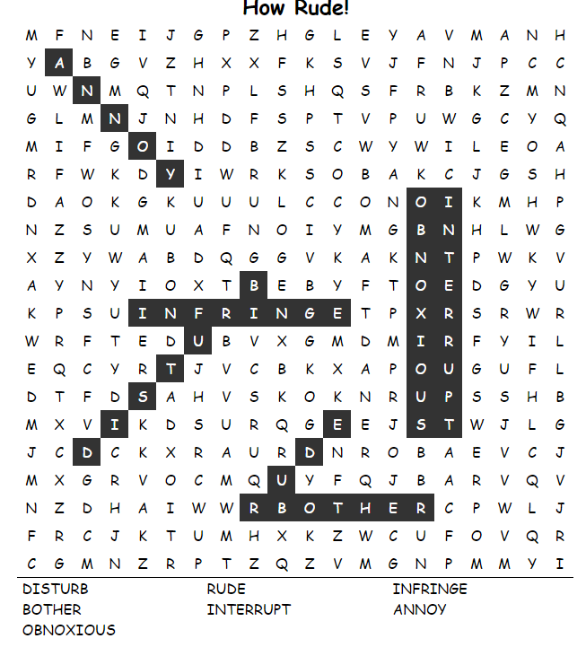
Levels of Awareness - Low
Priming
Notes:
In this slide, the instructor introduces the concept of non-conscious processing. This includes subliminal cues and priming. The image to the right shows a word search puzzle containing words related to rudeness. Many of these words were those used by Bargh & Burrows (1996), in a priming study in which they primed interrupting behavior in a group of participants exposed to these stereotypes. In that study they found that more than 60% of the “rude condition” participants interrupted the experimenter while being made to wait 10 minutes for them to finish a conversation. By contrast, only about 40% of the participants in the control condition interrupted during the 10 minute period.
This is an opportunity to explain priming and to gauge student skepticism concerning this phenomenon. Are there instances in which the students believe that their attitudes or behaviors are affected by external sources such as advertising or other influences?
This is also a potential opportunity to address the so-called “replication crisis in psychology.” Priming studies are among the most scrutinized because many highly cited studies have not replicated. See the Noba module “The Replication Crisis in Psychology” for an in-depth discussion of this issue, especially in relation to priming studies: http://noba.to/q4cvydeh

Slide 6
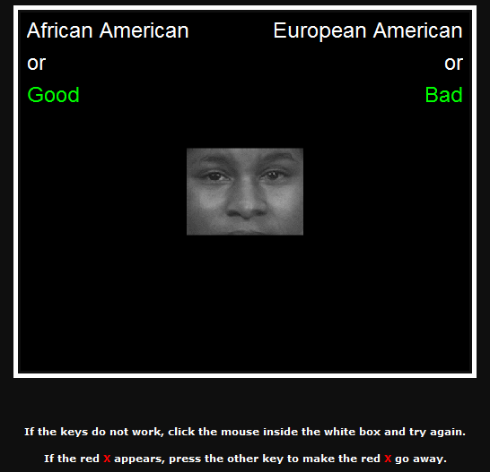
Levels of Awareness - Low
Implicit Association Test
Notes:
In this slide the instructor has the opportunity to discuss research methodology; specifically, the implicit associations test. The image on the right is an actual screenshot of an IAT study in which respondents use one of two keys to quickly make evaluations.
Historically, measuring sub-conscious or non-conscious thoughts and attitudes is difficult because people cannot, by definition, accurately report on them. In the late 1990s Anthony Greenwald and his colleagues developed this measure based on computer reaction time. The IAT works by forcing people to make evaluative pairings, such as pairing the word African American with the word good and the word bad. Participants quickly respond and the computer measures their reaction time in thousandths of a second. Thus, the measure is sensitive to very minute delays or differences in responding. Even if people want to “fake” the IAT (as in the case of only answering “good” for every ethnic minority because that is the socially appropriate response) they may not be able to do so as quickly as they would do if they were reacting naturally (assuming, in this example, that their true natural reaction is a slight bias against the group). For this reason, the IAT has gained popularity as a measure of bias.
Consider asking your students for their reactions to this measure: what are potential advantages or disadvantages of this measure? Possible answers:
-- familiarity: as respondents become more familiar with stimuli, their responses might speed up (this can be overcome by familiarizing participants with the procedure using dummy items)
-- slow responding may be indicative of cultural stereotypes rather than individual attitudes (although the two could be blended as well)
-- faking: people could consciously seek to speed up or slow down responses in an effort to fake results. This can be compensated for by taking baseline reactions on dummy measures or by creating threshold scores (eg. Throwing out any response that is longer than 950 milliseconds)

Slide 7
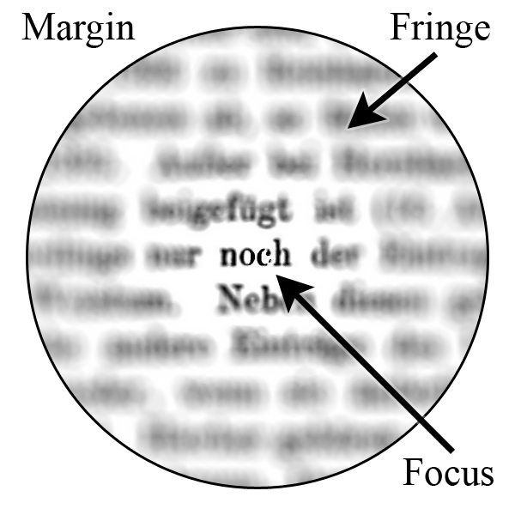
Levels of Awareness - High
Mindfulness
Notes:
This slide introduces the topic of high levels of awareness. Higher levels of awareness are characterized by the ability to focus attention. Ask students for examples of times throughout the day or week in which they feel most focused (at the highest level of awareness). What commonalities do they see between high versus low awareness situations. Possible answers:
-- higher stakes (more dire consequences for being wrong or not paying attention)
-- when performance is evaluated such as during a test or an athletic competition
-- when they care about the process or outcome (note: emotion and motivation and values factor in to sustaining attention)
Note: maintaining focused attention is distinct from self-awareness. The concept of “flow” (being in the zone) provides a good example of this. When a person’s skill is optimally matched to the challenge at hand they tend to lose track of time and become absorbed completely in the activity. Interestingly, the person loses their sense of self (low self-awareness) even though their attention is highly focused.

Slide 8
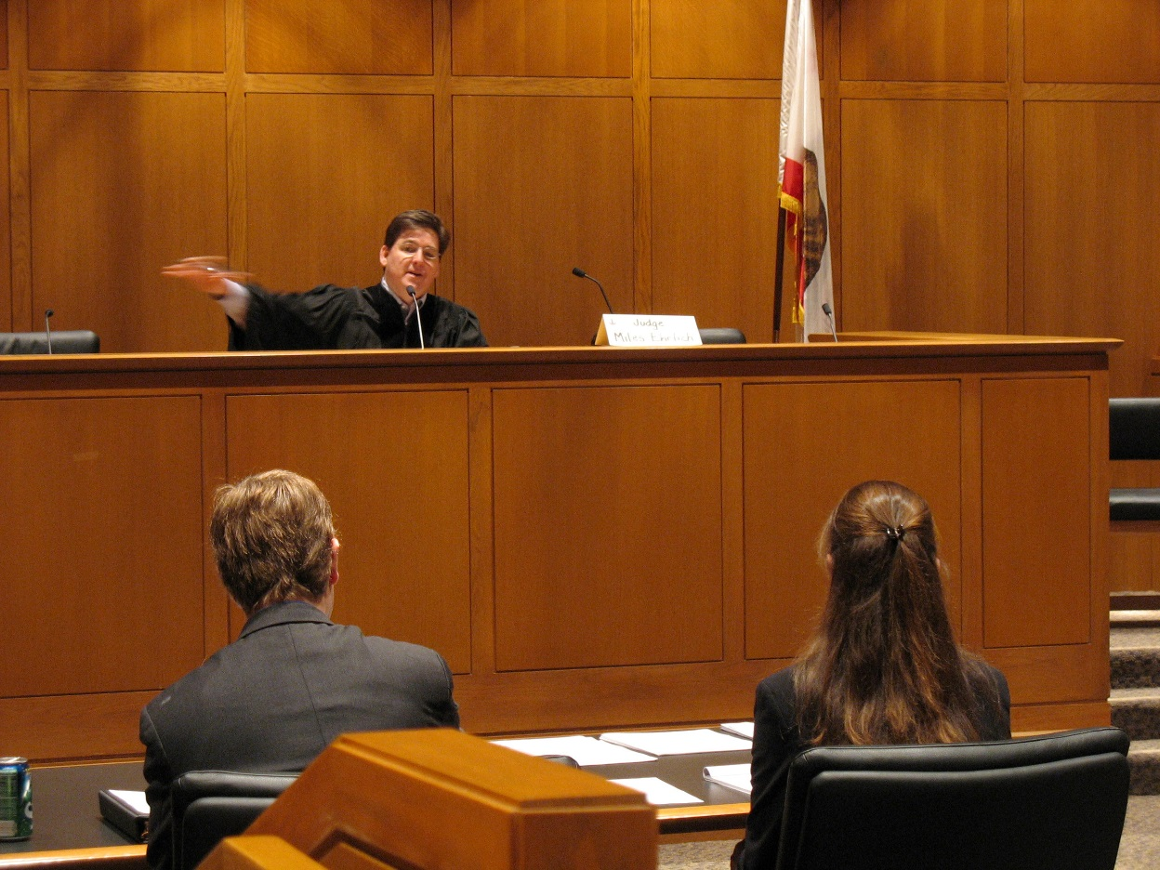
Levels of Awareness - High
Flexible Correction Model
Notes:
In this slide the instructor can introduce the flexible correction model. In this model it is assumed that individuals are able to correct for potentially biasing influences. To help explain this point have students think about being a judge in a courtroom.
“You have all seen television programs or movies in which a person is on trial. Sometimes a witness offers a piece of objectionable testimony and the judge instructs the jurors to disregard the testimony. Is it possible for them to do so?” Here, you might have students discuss this issue in pairs or small groups. Why do students hold the opinions they do? Subsequent to this discussion you might try this activity:
Activity: Disregard information
Overview: Liza has a certificate in computer programming and two years of experience with a wide range of programming projects. She is applying for a job as a computer programmer and you have been asked to review her application and make a determination about hiring her. She is also a very honest person. She once informed an employee of a bank that he accidentally gave her four times the amount of money that she had requested. She returned the extra money, which would not have been otherwise traced back to her.
Scenario One: It turns out that you have been given this information when you should not have been. This information about Liza being honest and returning the money is confidential. You should disregard this information in making your determination.
Scenario Two: It turns out you have been given some of this information when you should not have been. This information about Liza being honest and returning the money is a mistake– it is a story about a different individual and never happened to Liza. You should disregard this information in making your determination.
-- In which scenario do you think it would be easier to disregard the information? Why?
Note: If the students say “scenario two” it is because it is easier to disregard info that is inaccurate. This is the heart of the flexible correction model. If an individual is aware that certain information is biasing an attitude– such as current emotional state– it can be more easily dismissed and counter-acted as incorrect information and disregarded.
Solicit examples from the class (knowing you are too hungry to make a good decision; knowing pressure from your parents is affecting your attitude; knowing that stereotypes– of homeless people, for instance– color your opinion).

Slide 9
Costs & Benefits of Awareness
 | Costs | Benefits
Low Awareness | Influenced by subtle factors | Saves mental effort
High Awareness | Uses mental effort | Can overcome some biases
Notes:
This slide depicts various costs and benefits of both high and low awareness. Many students find this helpful in understanding why humans do not just default to one state of awareness all the time.
Activity: Personal Reflection
You may consider asking students to identify instances in which they are in each of these four quadrants. They might write down examples– perhaps from the previous 24 hours– on a piece of paper and label the specific costs and benefits associated with those particular examples. If time allows you might have them offer examples to the class in a large group discussion or share their reflections with a partner. You may also explore the extent to which students have a preference for high or low awareness states. Do some states feel more pleasurable than others? More relaxed than others? How much agreement or disagreement is there across the class?

Slide 10
Overview
Levels of Awareness
Other States
  Hypnosis
  Trance
Sleep
Psychoactive Drugs
Notes:
This slide provides students with an overview of the material that will be covered during the lecture. Here, the instructor indicates that he or she will be discussing other states of consciousness including hypnosis and trance.

Slide 11
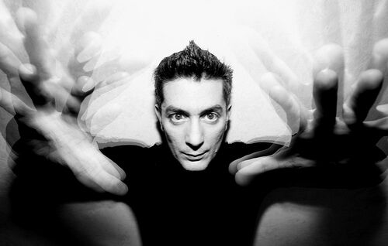
Other States - Hypnosis
Historical
Popular
Therapeutic
Notes:
This slide introduces the topics of hypnosis and trance, Some instructors may choose to skip this section. The primary points of interest related to hypnosis are:
Historical
Popular
Therapeutic
You may want to choose a single angle from which to discuss hypnosis.
(Click): Historical: Dr. Franz Anton Mesmer (1734-1815) was a physician who was interested in magnetic therapies, séances, and similar alternative therapies. Mesmer was denounced by the medical community in Vienna and went to live in Paris, where he was similarly rejected by the scientific establishment. https://en.wikipedia.org/wiki/Franz_Mesmer. Another historical figure associated with hypnotism is Jean-Martin Charcot (1825-1893), a physician whose students included Freud and Binet. Charcot studied neurology and thought that hypnosis was a state that was linked to symptoms of “hysteria.” He did not use hypnosis therapeutically but did use it to demonstrate symptoms of hysteria to his colleagues. https://en.wikipedia.org/wiki/Jean-Martin_Charcot
(Click): Popular: Many of our stereotypes of hypnosis come from movies or comedy stage shows. Here is a video link to the popular American TV program “American Idol” in which one of the judges– Howie Mandel, well known for having OCD and refusing to shake hands with people– is apparently hypnotized into shaking hands. If you screen this video you may want to ask students for their reactions. Common student reactions include skepticism (Mandel was “in on it”), mild skepticism (“Mandel was just following directions but would not do anything he did not want to do”) or non-skepticism (“Mandel’s mind was under the influence of outside power”). You only need to show the first 3 minutes 30 seconds of the video: https://www.youtube.com/watch?v=f9dFLXV9hs0
(Click): Therapeutic: Hypnosis is used for the treatment of addiction (eg. Smoking cessation) as well as pain tolerance. In this 6 minute video Lucas Handwerker– a stage hypnotist– offers thoughts on the therapeutic aspects of hypnosis. https://www.youtube.com/watch?v=zepp_H6K5wY

Slide 12
Overview
Levels of Awareness
Other States
  Hypnosis
  Trance
Sleep
Psychoactive Drugs
Notes:
This slide provides students with an overview of the material that will be covered during the lecture. Here, the instructor indicates that he or she will be discussing sleep.

Slide 13

Sleep
Factors influencing good sleep
Effects of sleep loss
Sleep Disorders
Notes:
In this introductory slide on the topic of sleep you can offer basic definitions of some of the most important aspects of sleep:
(Click): Factors influencing good sleep: Humans (compared with other animals) need about 8 hours of sleep per night to function well. Sleep is regulated by circadian rhythms which are, themselves, influenced by exposure to daylight. This dictates when the hormone melatonin is produced (the evening hours, typically) and this is associated with the onset of drowsiness. Many factors can upset the natural sleep cycle: the use of caffeine or other stimulants, shift work that requires long hours or nighttime hours, and international travel (jet lag) are 3 examples.
(Click): Effects of sleep loss: Sleep loss– whether it is through interrupted sleep or just too few hours– is associated with a variety of problems. Sleep can negatively impact mood– it is associated with irritability, depression, and lethargy. Sleep loss can also adversely affect thinking. For instance, sleep loss is associated with slower reaction times and a decreased ability to focus. Finally, sleep loss is related to obesity. Poor sleep increases the stress hormone cortisol, which is associated with storing fat; it is also associated with decreasing leptin, a hormone associated with suppressed appetite.
(Click): Examples of Sleep disorders include: insomnia (the inability to sleep), narcolepsy (spontaneously falling asleep when you shouldn’t), sleep apnea (interrupted breathing that interferes with restful sleep),
Discussion: Sleep is an issue for many students. Here, you can engage them in a discussion about what they notice about their own sleep habits. How many hours of sleep do they aspire to? How many do they actually get? What factors interfere with their sleep? What consequences of poor sleep do they notice?

Slide 14
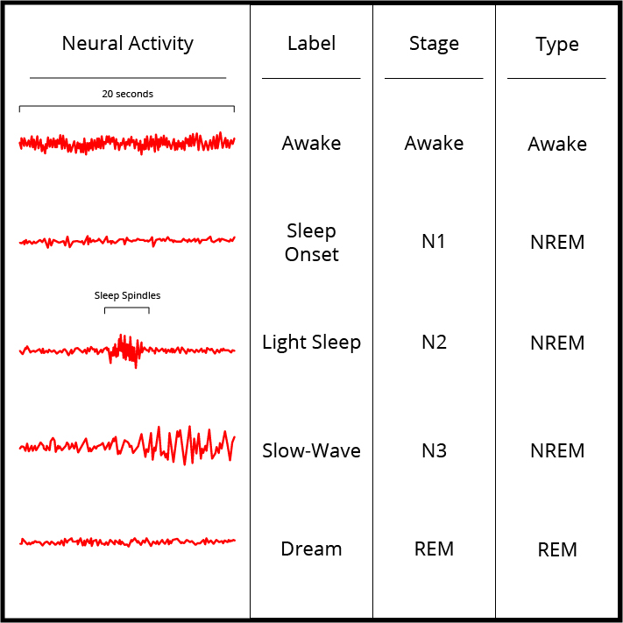
Stages of Sleep
Characteristics of stages:
Awake
Stage 1: Light sleep
Stage 2: Moderately light, spindles
Stage 3: Transitional
REM: Dream sleep
Notes:
This slide presents the stages of sleep. Here, you introduce the idea that sleep occurs in cycles lasting 90-120 minutes.
Characteristics of stages:
(Click):
Awake
Stage 1: Light sleep
Stage 2: Moderately light, spindles
Stage 3: Transitional
REM: Dream sleep
As a person begins to fall asleep (a light sleep) their brain activity changes and each stage of sleep is defined by a unique pattern of brain activity (see the Figure on the slide). Earlier stages are NREM (non-REM) sleep and are characterized by waves of varying amplitude and frequency. Dreaming occurs during REM (rapid eye movement) sleep. The pattern of brain activity here is “saw-toothed” and mirrors that of wakeful periods.

Slide 15

Dreams
Dream Research
Notes:
This slide introduces the topic of dreams. Dreams are, arguably, the most intriguing aspect of sleep. Dreams can be scary, embarrassing, pleasurable, or simply bizarre. People have given dreams special importance throughout history: they have been viewed as a window into a spirit world, hints of unconscious or taboo desires, and attempts to make sense of daily life. Despite their high interest potential this may be one topic that you cut from this lecture if you are concerned about time constraints.
One of the historical intersections between psychology and dreaming is through dream interpretation. Most associated with Freud as a therapeutic technique, dreams can be thought of as having 1) manifest content– the actual theme and subject matter of the dream, and 2) latent content—symbolic meaning of the subject matter of the dream.
Possible Video & Discussion: Here is an interesting TED talk on dream research (run time: 14 minutes): https://www.youtube.com/watch?v=y9ArPNAOHCo

Slide 16
Overview
Levels of Awareness
Other States
  Hypnosis
  Trance
Sleep
Psychoactive Drugs
Notes:
This slide provides students with an overview of the material that will be covered during the lecture. Here, the instructor indicates that he or she will be discussing psychoactive drugs.

Slide 17

Drugs - Hallucinogens
Self-Portrait
Notes:
This slide introduces halluciongens. Hallucinogens include psychedelic mushrooms, peyote, LSD, DMT-100, PCP, ketamine (Special-K) and other drugs. Most hallucinogens are illegal, although some are widely used in traditional ceremonies. Hallucinogens alter consciousness by affecting perception of time, and often create visions that are not real (eg. Pulsating walls or furniture, geometric patterns moving across surfaces).
Video: Here is a one minute video of an artist who, in the 1950s, drew periodic self-portraits while on LSD http://www.openculture.com/2013/10/artist-draws-nine-portraits-on-lsd-during-1950s-research-experiment.html

Slide 18

Drugs - Stimulants
Stimulants are highly addictive
Notes:
Here, you will introduce the topic of stimulants to the class. Caffeine is the most widely used stimulant and is found in coffee, tea, and nicotine is found in tobacco products. Caffeine can also lead to anxiety, insomnia, restlessness, and uncomfortable withdrawal states.
Many stimulants, such as cocaine and methamphetamine, work by blocking the re-uptake of dopamine. This means that because dopamine is not taken back in it builds up, causing euphoria and accelerated thought and motor activation.
Stimulants are highly addictive.
Possible discussion: You may choose to have students reflect on their own caffeine use as a class or with a partner. Possible questions include:
-- How often do you use caffeine (if you do not use caffeine, is this a conscious choice?)
-- what age were you when you first started using caffeine (remember, caffeine is in soft drinks such as coca-cola)
-- What effects do you notice if you go for a period of time without caffeine? What effects do you notice once you take caffeine?

Slide 19
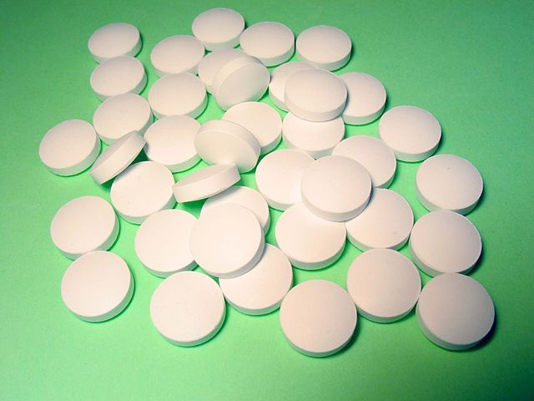
Drugs - Depressants
Depressants suppress the nervous system
Notes:
This slide continues the discussion on drugs and introduces depressants.
The most common depressants used– apart from alcohol-- are those used for medical purposes such a pain killers. Many pain killers are derived or synthesized from opium, which comes from poppy flowers. For this reason, pain killers are often called “opiates.” Depressants get their name because, as a category of drug, they tend to suppress the central nervous system, often through the mechanism of initiating the production of GABA, a neurotransmitter associated with “quieting” the nervous system. It is for this reason that some depressants– benzodiazepines such as valium are also prescribed to treat anxiety.

Slide 20
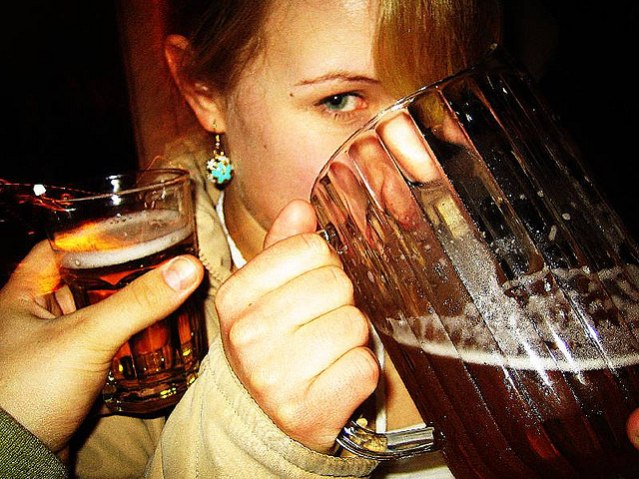
Drugs - Alcohol
Indicators of disorder
Cannot cut down or stop
Frequently uses
Uses despite negative consequences
Use interferes with work or relationships
Experiences tolerance
Hides use
Notes:
Of all the drugs alcohol is the most commonly used. Alcohol is toxic to human physiology. In small doses it produces euphoria. Side effects include a reduction in inhibition and the loss of balance and coordination. At higher doses alcohol can lead to unconsciousness and death. Alcohol is also addictive and associated with a wide range of problems including relationship difficulties and risk-taking behaviors.
Below are 6 indicators of disordered alcohol use. These are not the only indicators, nor does having one mean that an individual is an “alcoholic.” You may consider opening a discussion with your students regarding their observations about alcohol use among the student body.
Indicators of the disorder:
(Click): Cannot cut down or stop
(Click): Frequently uses
(Click): Uses despite negative consequences
(Click): Use interferes with work or relationships
(Click): Experiences tolerance
(Click): Hides use
Possible questions include:
Have you ever seen someone drink too much? What were the consequences?
How common is alcohol in student social functions? To what extent do you think this mirrors the alcohol use of other adult groups? If student use appears different why do you think this is?

Slide 21
Conclusion
Levels of Awareness
Other States
  Hypnosis
  Trance
Sleep
Psychoactive Drugs
Notes:
With this slide you can remind students of what they have just learned:
-- Consciousness is not like an on-off switch but is more like a dimmer switch that can be turned from low to high across a continuum. Low consciousness includes sleep, hypnosis, and day dreaming. Higher consciousness requires greater effort and sustained focus.
-- Sleep is a unique state of consciousness in that it is a drive state and basic need for psychological and physical well-being
-- People have long used drugs as means of altering their states of consciousness including minimizing pain, promoting recreational pleasure, and exploring spirituality.

Slide 22
Photo Attribution
Slide 1 | Photo Credit: brain lobes Allan Ajifo https://www.flickr.com/photos/125992663@N02/14599057004 https://creativecommons.org/licenses/by/2.0/
Slide 2 | Photo Credit: Tough Choices...Daniel Lee https://www.flickr.com/photos/dlee13/14072309735/in/photolist-nrwgpV-atBWtX-dJX1na-6LCCiH-iRgkU3-rM6b9-bwpVQ7-8fSC3q-858Xjp-auaVLg-7JnnnQ-8FAKmw-7TCUKt-ctqQj3-4ZrNGm-7xvabP-9DWf1Z-667wTz-57y5ht-5Dax8k-4gWkrF-cVFAUY-9vpdf7-nvHcJY-57w9pS-nuKqWM-8VyHwP-aQnVH4-6GizX8-jjwNRg-fCJnpZ-V9mHc-nfAvWy-7sVudE-bERCRK-4nokvC-2y2FWC-2V9ANo-fa1UgV-nECyZG-nzxsA8-fWkWvy-f9VuBv-9yzCWd-aiJFxH-pL6raG-pf8QC5-nPgp6U-fwJtn4-pmXfv2 https://creativecommons.org/licenses/by-nc-nd/2.0/
Slide 4 | Photo Credit: Serene Calmness Gane https://www.flickr.com/photos/19396720@N00/5401396747/ https://creativecommons.org/licenses/by/2.0/
Slide 6 | Photo Credit: IAT Snapshot Used with the Permission of Anthony Greenwald from Project Implicit https://implicit.harvard.edu/implicit/
Slide 7 | Photo Credit: The spotlight model of attention. Lovearobot. https://en.wikipedia.org/wiki/Attention#/media/File:Wikipedia-spotlight.jpg Public Domain
Slide 8 | Photo Credit: maveric2003 American judge Miles Ehrlich talking to a lawyer. https://en.wikipedia.org/wiki/Judge#/media/File:Miles_Ehrlich,_judge.jpg http://creativecommons.org/licenses/by/2.0/
Slide 11 | Photo Credit: Hypnosis Massimo Regonati https://www.flickr.com/photos/17927408@N07/2341517672/ https://creativecommons.org/licenses/by-nc-sa/2.0/
Slide 13 | Photo Credit: Untitled Fatimeh Nadimi https://www.flickr.com/photos/35517240@N04/14944013339/ https://creativecommons.org/licenses/by-nc-nd/2.0/
Slide 14 | Photo Credit: Figure 2 OpenStax CNX http://cnx.org/contents/4abf04bf-93a0-45c3-9cbc-2cefd46e68cc@1.76:22/Stages-of-Sleep http://creativecommons.org/licenses/by/3.0/
Slide 17 | Photo Credit: spectrum Sheldon Wood https://www.flickr.com/photos/20005495@N00/61581039/ https://creativecommons.org/licenses/by-nc-sa/2.0/
Notes:
Photo Attribution Slide

Slide 23
Photo Attribution
Slide 18 | Photo Credit: Coffee cup Personeelsnet https://www.flickr.com/photos/personeelsnet/2516485092 https://creativecommons.org/licenses/by-sa/2.0/
Slide 19 | Photo Credit: Pharmaceutical drugs have various known and unknown effects on the environment. Slashme https://en.wikipedia.org/wiki/Environmental_persistent_pharmaceutical_pollutant#/media/File:FlattenedRoundPills.jpg http://creativecommons.org/licenses/by-sa/3.0/
Slide 20 | Photo Credit: midtown 198 Zach Slootsky https://www.flickr.com/photos/81324440@N00/111618950/ https://creativecommons.org/licenses/by-nc-nd/2.0/
Notes:
Photo Attribution Slide

